Slide 1
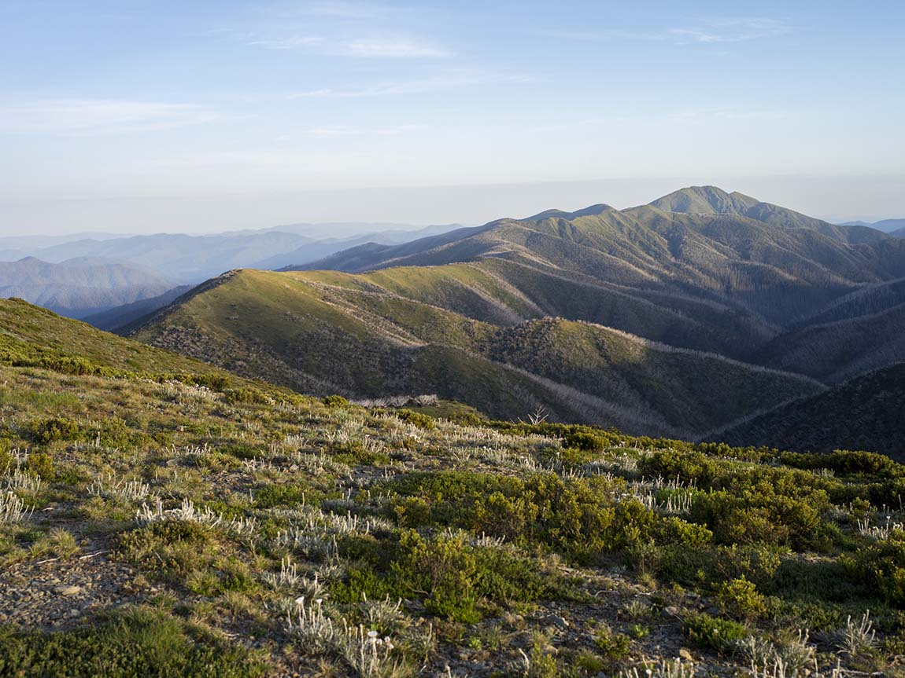

** INSERT TOWN NAME HERE **

Slide 2

WELCOME!
Are you ready to test your knowledge about emergency readiness,
response and recovery?

Slide 3
Rules of the game

Slide 4

FIRST Category

Slide 5

Name 5 of the 6 Fire Danger Ratings

Slide 6
Leaving early is the safest option to protect yourself
and your family
True
or
False

Slide 7

second Category

Slide 8

Name 5 of the 6 Fire Danger Ratings

Slide 9
Leaving early is the safest option to protect yourself
and your family
True
or
False

Slide 10

THIRD Category

Slide 11

Name 5 of the 6 Fire Danger Ratings

Slide 12
Leaving early is the safest option to protect yourself
and your family
True
or
False

Slide 13

FOURTH Category

Slide 14

Name 5 of the 6 Fire Danger Ratings

Slide 15
Quotations are commonly printed as a means of inspiration and to invoke philosophical thoughts from the reader.

Slide 16
THANKS!
Any questions?
You can find me at @username & user@mail.me

Slide 17

Credits …
Logo and presentation design, created and proudly supported
by Stik-it Bespoke Design.

